Slide 1
Electrical Service Design of A 16 Storeyed Building
Project By- (Group 2)
Tonmoy Roy(1706036)
Al Hasib (1706037)
Fariza Siddiqua(1706043)
Shoumik Debnath(1706050)
Swadesh Vhakta(1706061)
Imtiaz Ahmed(1706062)
Mehedi Hasan Megh(1706065)

Slide 2


Topics
Building Overview
Floor Plans
Floor Plan : Ground Floor
Floor Plan : Garage
Floor Plan : Typical Floor
Fittings and Fixtures
Fittings and Fixtures : Ground Floor
Fittings and Fixtures : Garage
Fittings and Fixtures : Typical Floor
Conduit Layout
Conduit Layout : Ground Floor
Conduit Layout : Garage
Conduit Layout : Typical Floor
Emergency Conduit Layout
Emergency Conduit Layout : Ground Floor
Emergency Conduit Layout : Garage
Emergency Conduit Layout : Typical Floor
6. Lightning Protection System(with Calculation)
7 . SwitchBoard Connection Diagram(with Calculation)
Ground Floor
Garage
Typical Floor
8. Emergency SwitchBoard Connection Diagram(with Calculation)
Ground Floor
Garage
Typical Floor
8. Sub Distribution Board Diagram(with Calculation)
Ground Floor
Garage
Typical Floor
9. Emergency Sub Distribution Board Diagram(with calculation)
Ground Floor
Garage
Typical Floor
10. Load Calculation Sample
11 . Substation Layout
12. Reference

Slide 3
Building Overview
We are designing a 16 storeyed Building.
There are 2 Units per floor.
We have 3 different types of floor designs
Ground Floor : Mainly works as an entrance for cars and pedestrians and Substation is situated Here.
Garage : Our 2nd and 3rd Floors are used as a garage to accommodate cars.
Typical Floors : This represents our Apartment designs which follows a common plan for all 16 storeys.
Lighting Protection system is added to prevent damages during lightning.
A Transformer and Generator is added to our substation situated in the ground floor.

Slide 4
Floor Plans

Slide 5
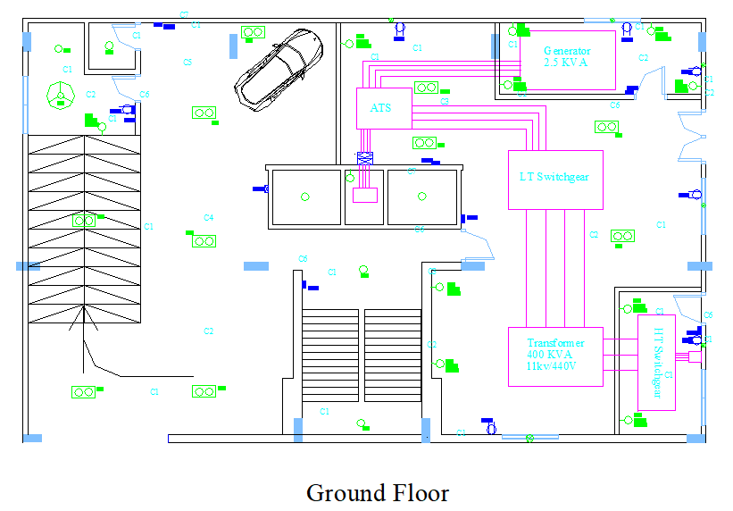
Ground Floor

Slide 6
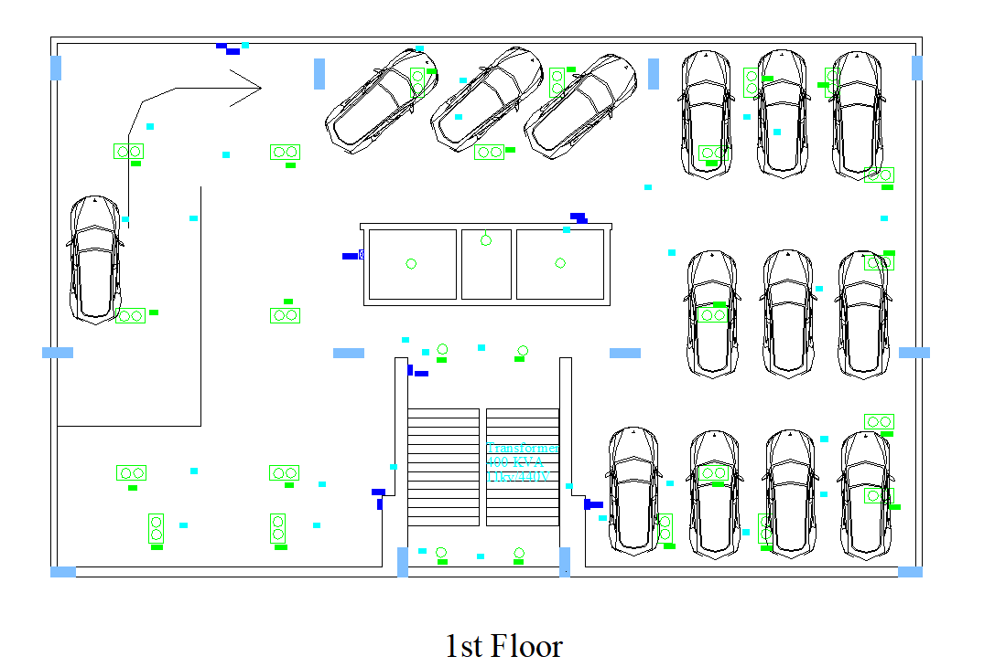
Garage

Slide 7
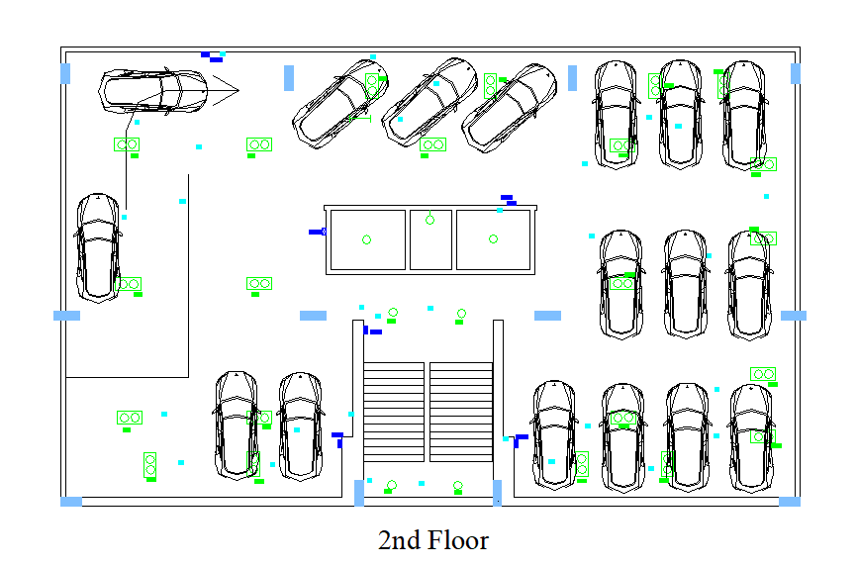
Garage

Slide 8
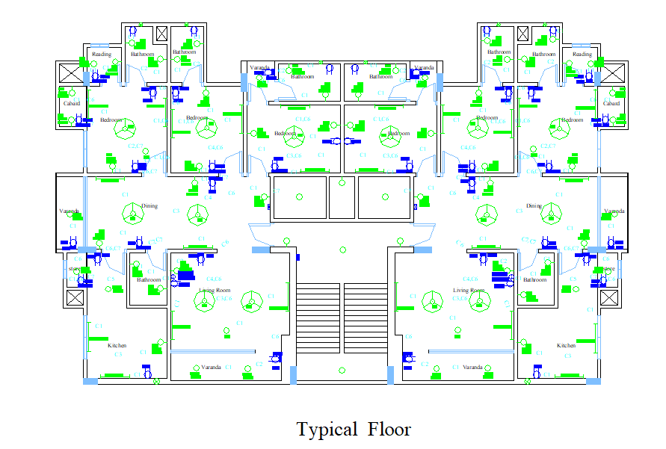
Typical Floor

Slide 9
Fittings and Fixtures

Slide 10
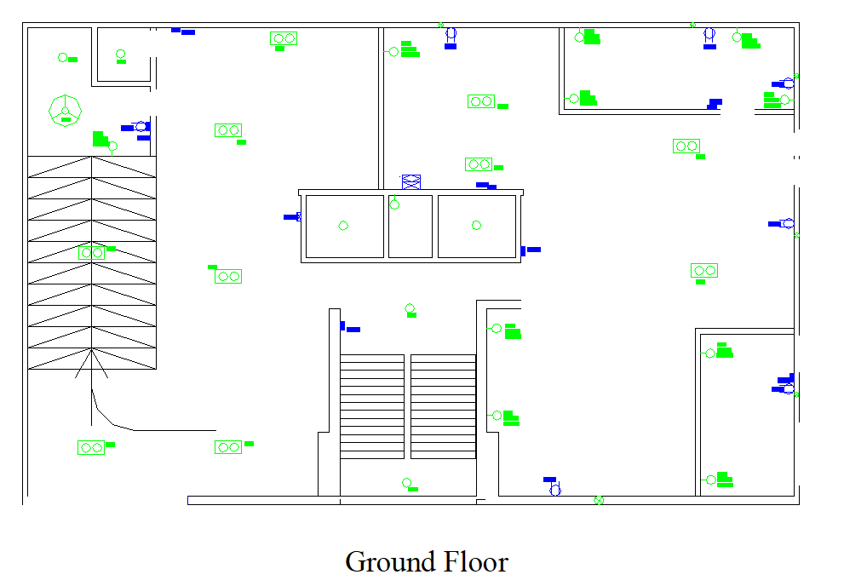
Ground Floor
Substation is situated on the right side of the design.
A guard room is provided under the car stair with proper arrangements.
Stairs are also shown.

Slide 11
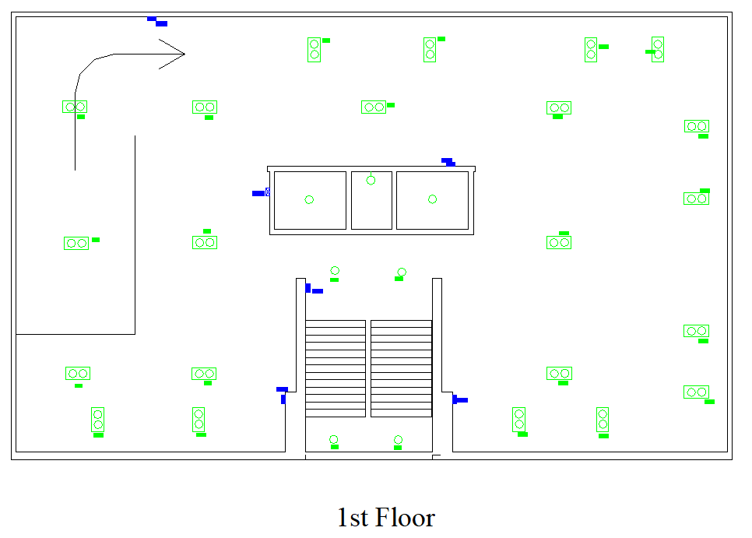
Garage

Slide 12
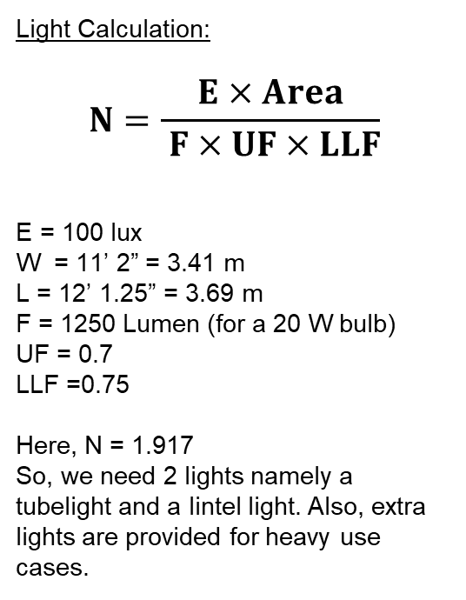
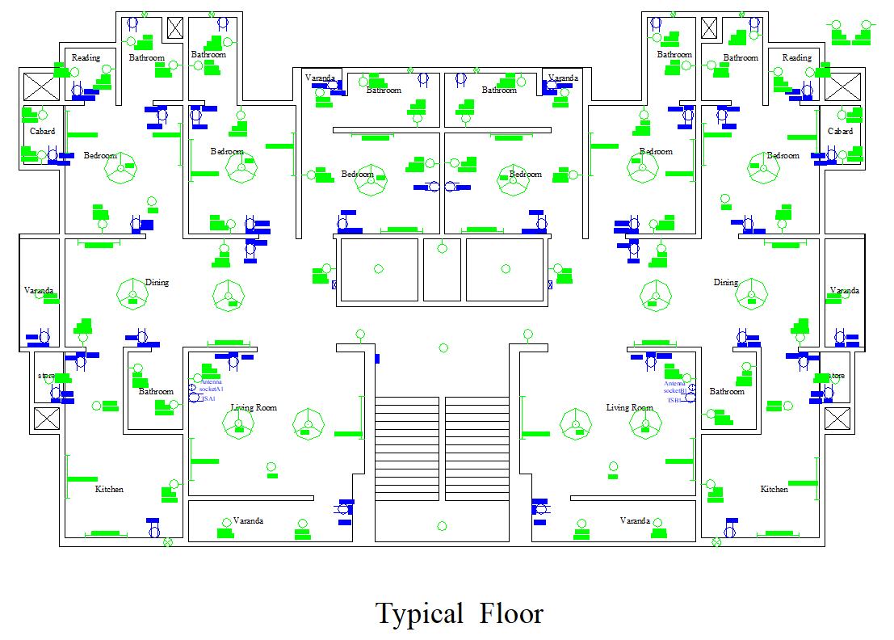
Typical Floor

Slide 13
Conduit Layout

Slide 14
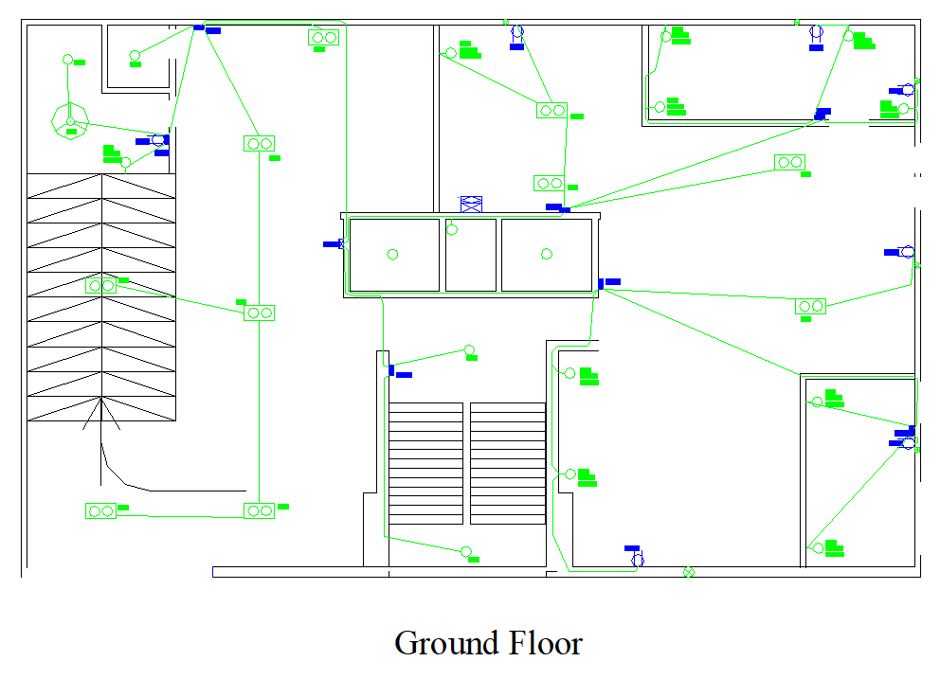
Ground Floor

Slide 15
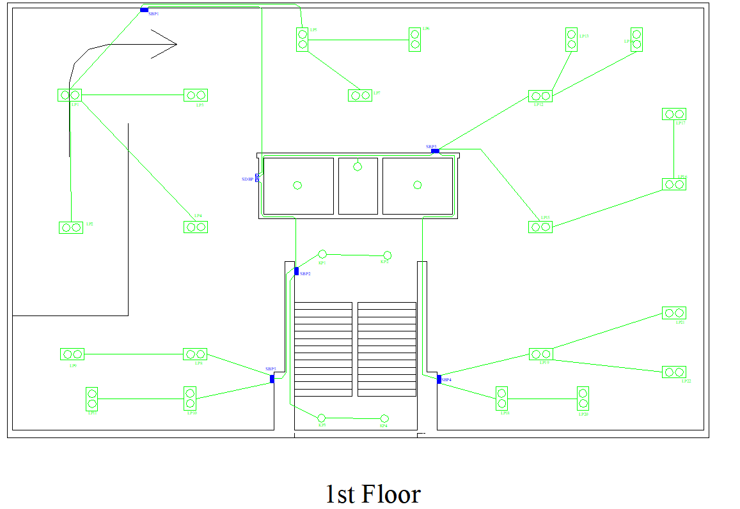
Garage
5 switch boards are used to control the lights.

Slide 16
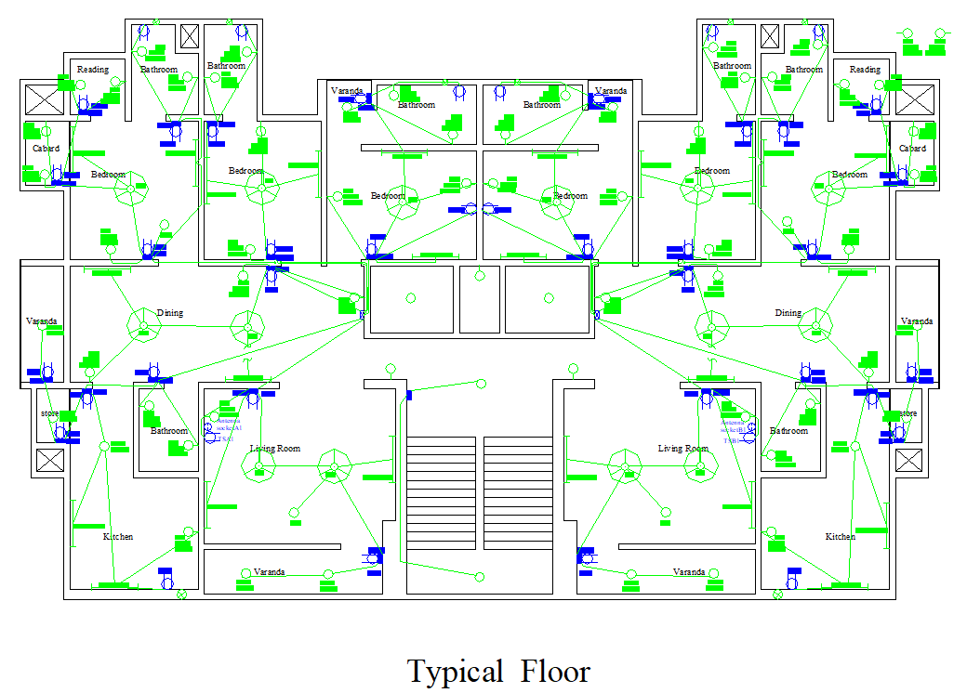
Typical Floor
C1 (5 Amp) conduits are used for all fans and lights.
C8(15 Amp) conduits are used for 3 pin sockets.

Slide 17
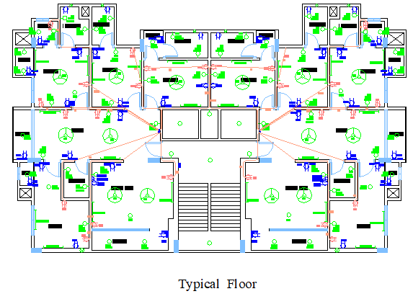
3 pin outlet conduit connections

Slide 18
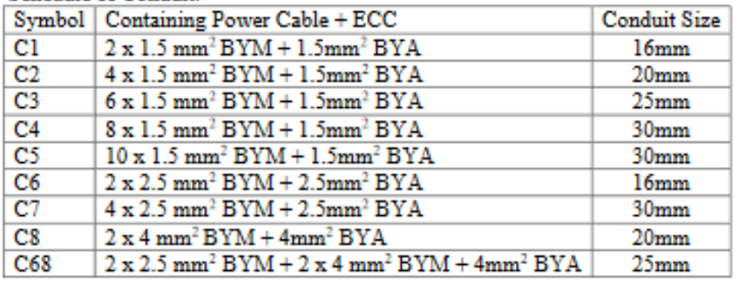
Conduit Schedule

Slide 19
Emergency Conduit Layout

Slide 20
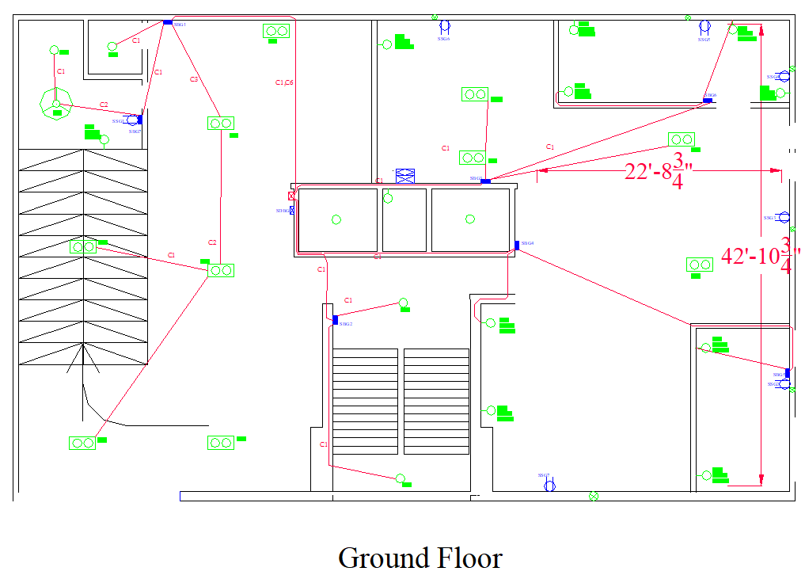
Ground Floor

Slide 21
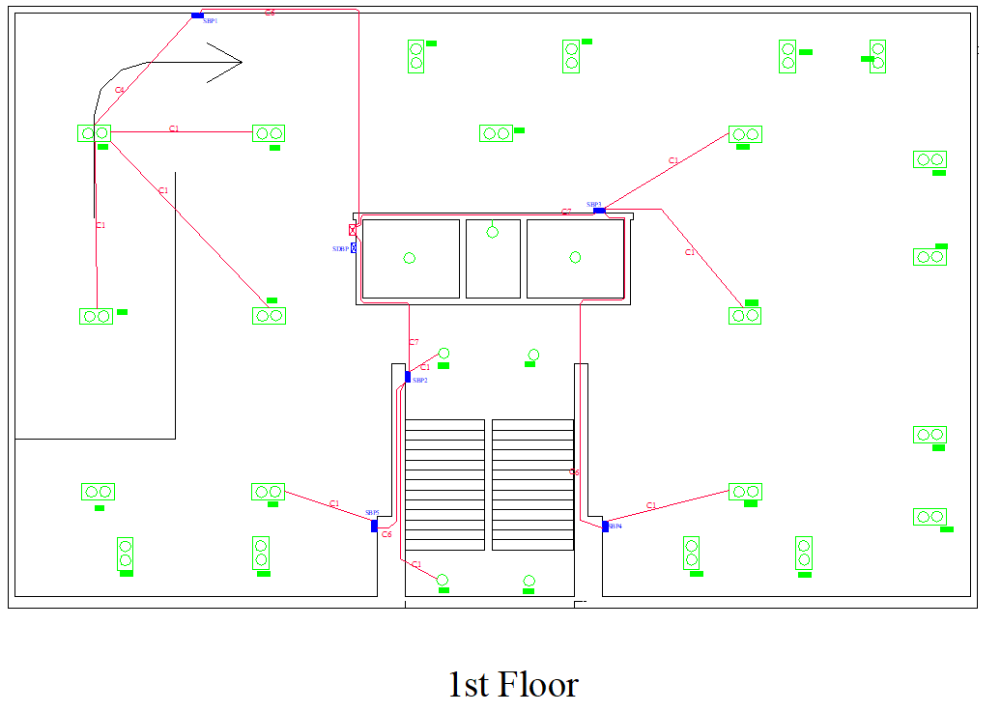
Garage

Slide 22
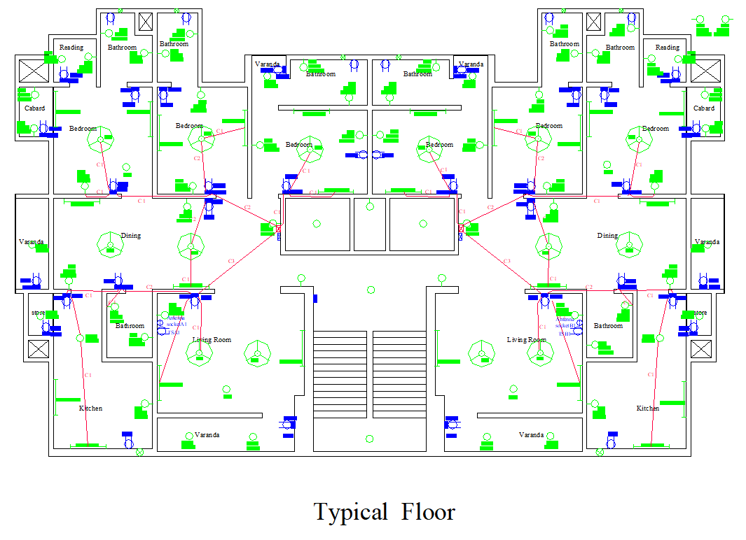
Typical Floor

Slide 23
Lightning Protection System

Slide 24
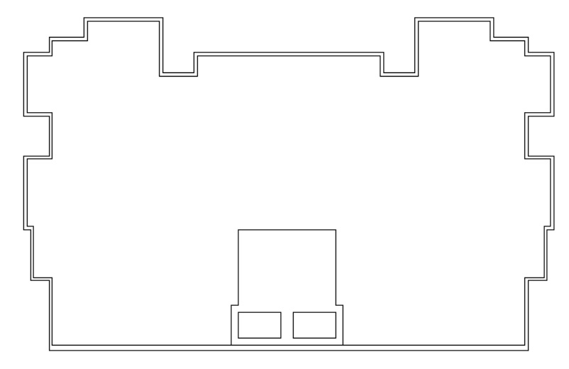








Lightning Protection System
Air conductor
Ground conductor
Roof conductor

Slide 25
Calculation For Lightning Protection System
Building Length= 80’5”
Building width= 45’2”
Air conductor calculation:
1 conductor at each of the four corners
Maximum distance between 2 air conductor= 25’ (arbitrary estimation)
So along length 3 air conductor is needed where distance between 2 consecutive air conductors is 20’1.2”
And along width 1 air conductor is needed where distance between to consecutive air conductors is 22.58’
The area of the rooftop of the building is 80’5” x 45’2”= 24.5x13.77 m²= 337.365 m²
Number of down conductors = one for first 80 sq metres, one more for each 100 sq metres
So total down conductor = 3
Reference: Lab sheet

Slide 26
Switchboard Connection Diagram

Slide 27
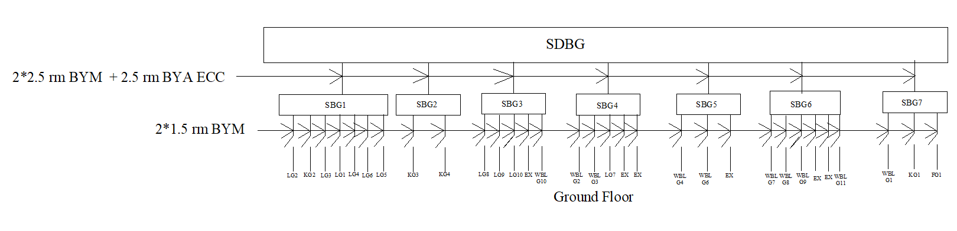
Ground Floor

Slide 28
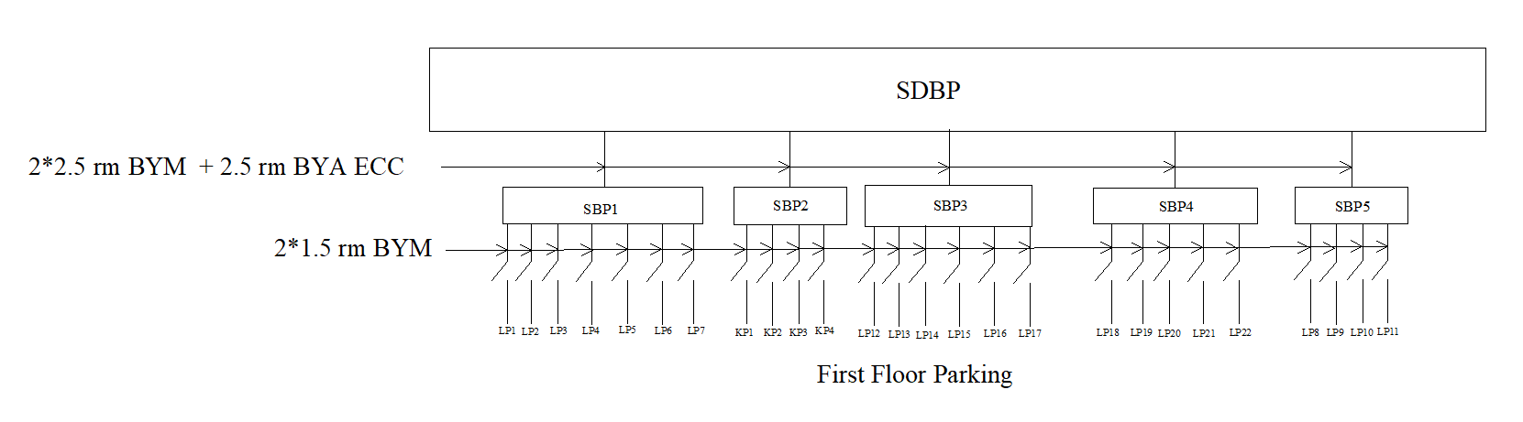
Garage

Slide 29
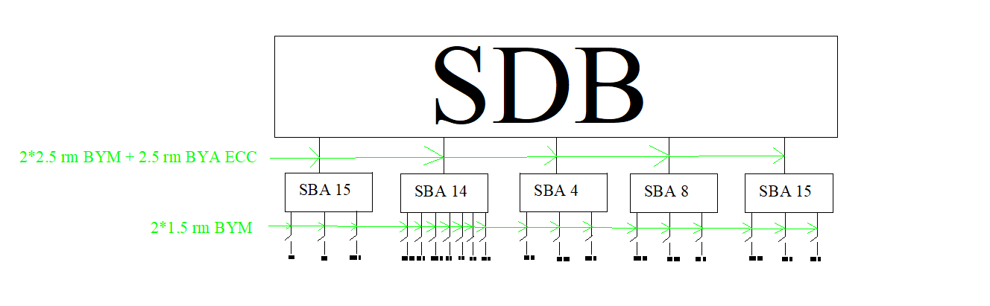
Typical Floor
7

Slide 30
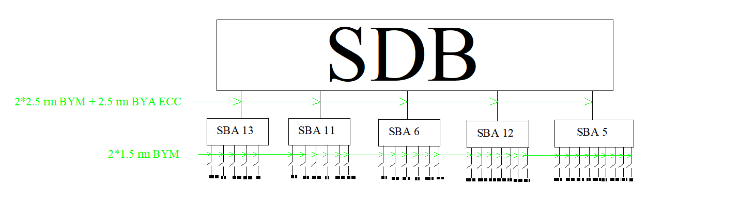
Typical Floor

Slide 31
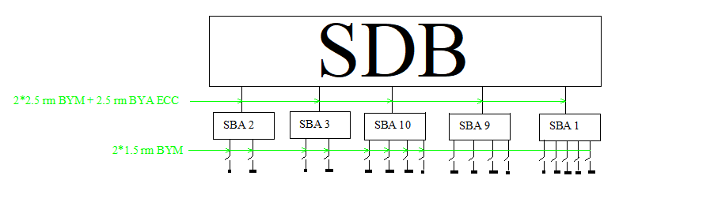
Typical floor

Slide 32
Emergency Switchboard Connection Diagram

Slide 33
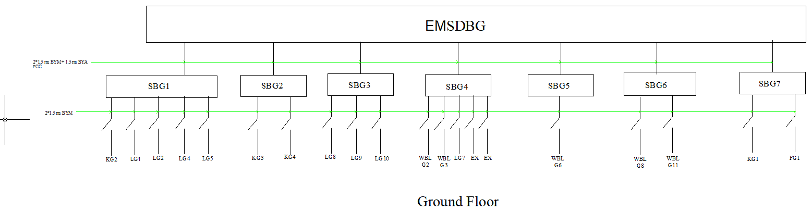
Ground Floor

Slide 34
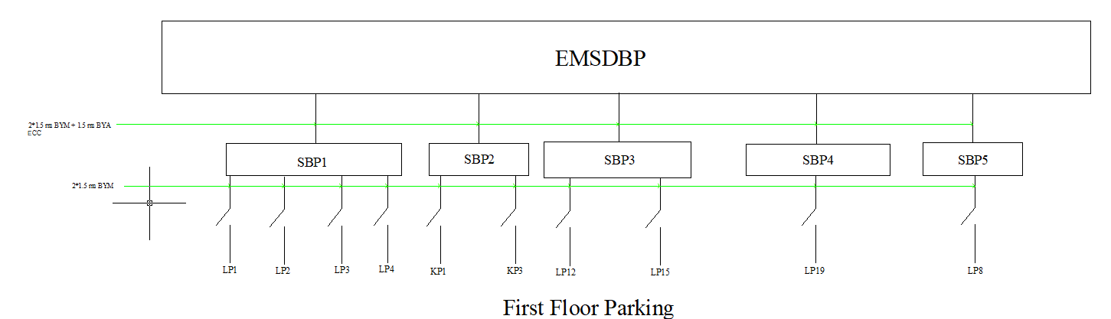
Garage

Slide 35
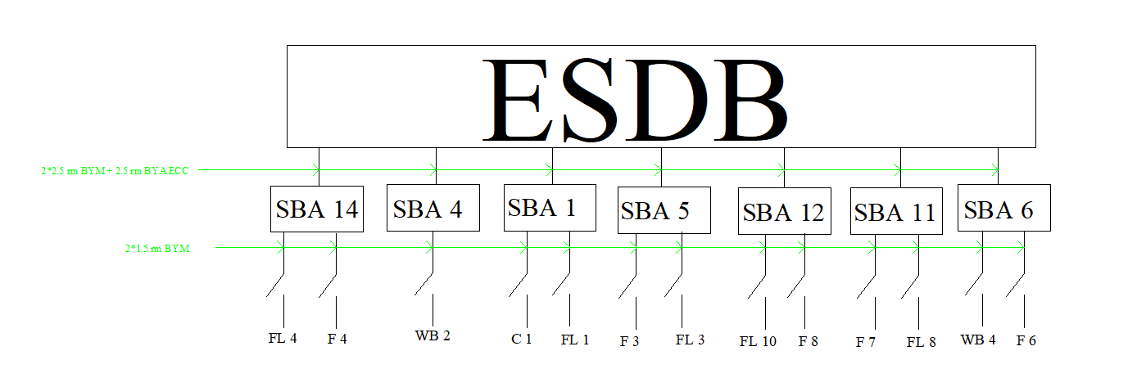
Typical Floor

Slide 36
Sub Distribution Board Diagram

Slide 37
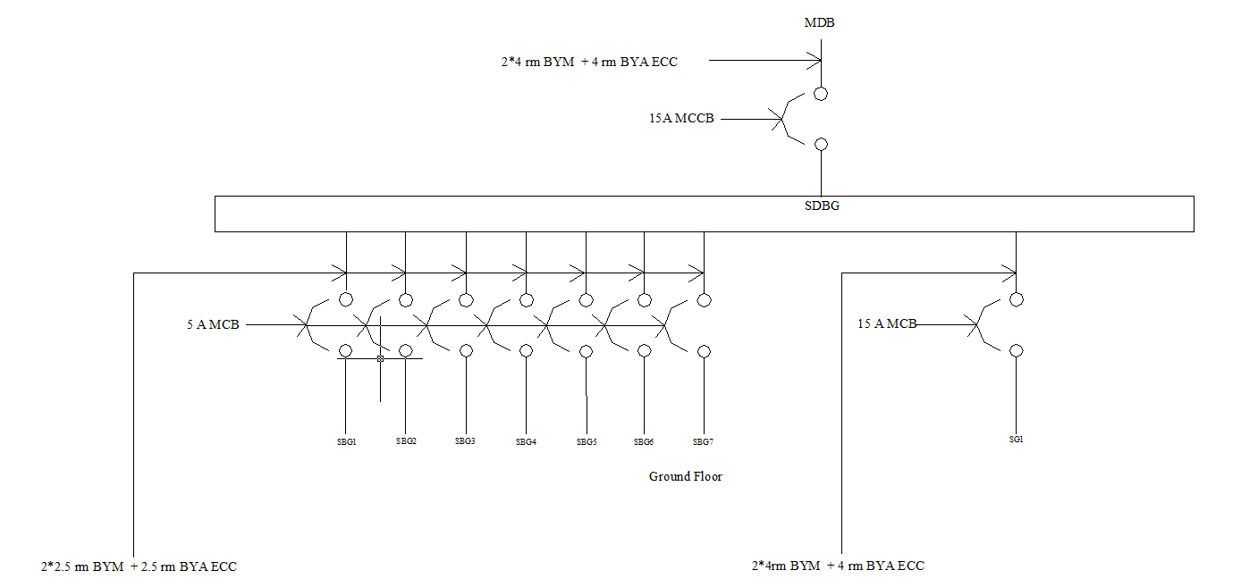
Ground Floor

Slide 38
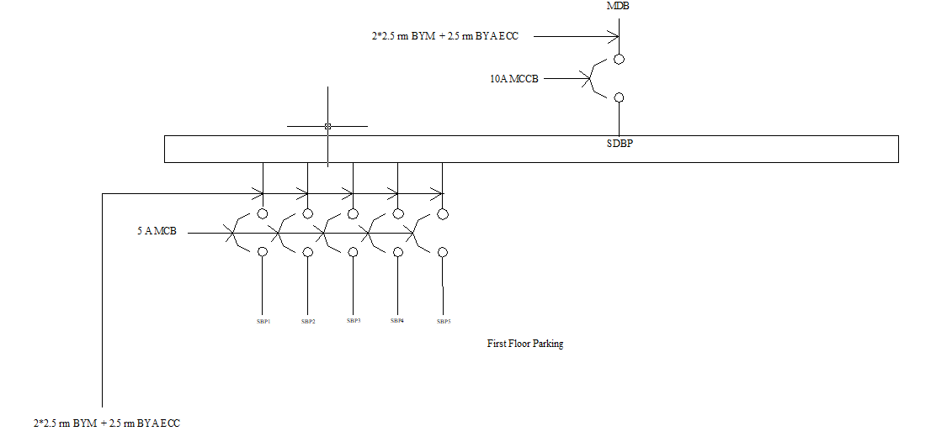
First Floor Parking

Slide 39
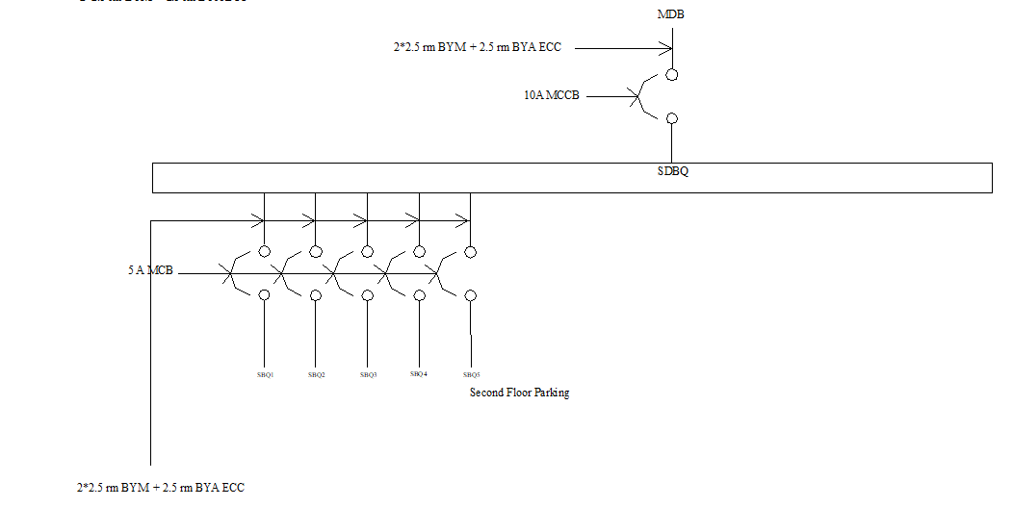
Second Floor Parking

Slide 40
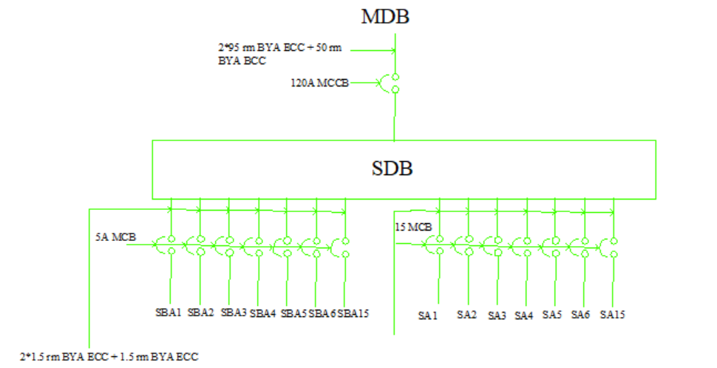
Typical Floor

Slide 41
SDB-Typical Floor Plan:Calculations
Under the switchboard SBA1,
Loads: Ceiling light-1x20 watts
Tubelight-2x30 watts
Wall-bracket light-1x20 watts
2-pin outlet-1x80 watts
Total load=180 watts; Total current=400/(220x0.8)=1.027 Amps. Using this method we get for other switchboards-SBA2=1.82A;SBA3=1.82A;SBA4=1.93A;SBA5=3.3523A;SBA6=4.5454A;SBA7=1.93A;SBA8=1.93A;SBA9=2.63A;SBA10=2.63A;SBA11=2.84A;SBA12=4.84A;SBA13=2.5A;SBA14=1.93A;SBA15=1.93A. Total=37.6547A
For 3-pin outlets=each have wattage of 3000 watts. Total current for 3-pins=(3000x15x0.3)/(220x0.8)=76.7A
Net total=76.7+37.6547=114.3547A

Slide 42
Emergency Sub Distribution Board Diagram

Slide 43
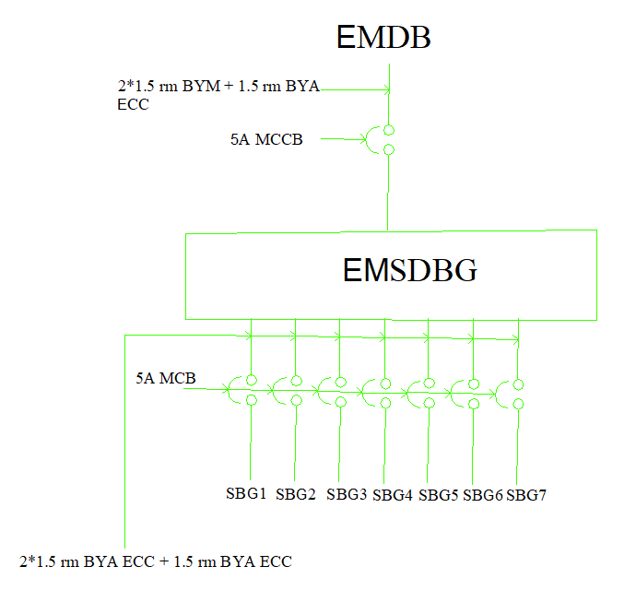
Ground Floor

Slide 44
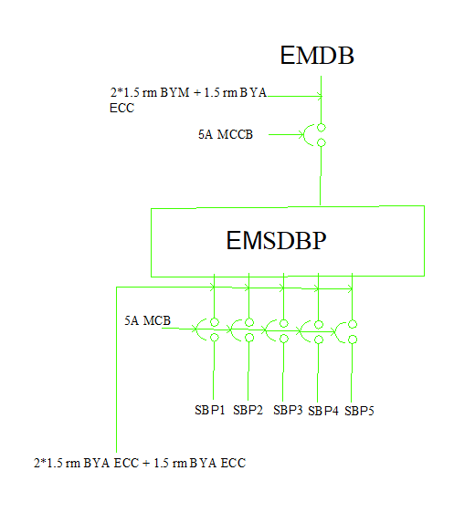
Garage

Slide 45
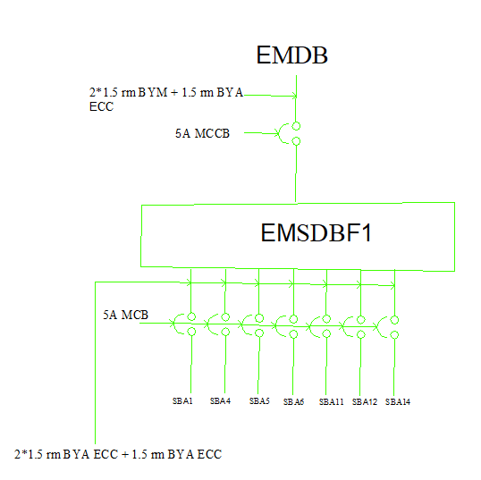
Typical Floor

Slide 46
Load Calculation Sample

Slide 47
Load Calculation Sample
We are designing a 16 storeyed Building.There are 2 Units per floor.
We calculated load for one unit first and then multiplied it by 32.Finally added overall building load.
Load of a unit:
Item Name | Item Quantity | Watt for Item(W) | Total (W)
Lintel Light | 30 | 30*20*0.8 = 480 | 10764
Tube light | 11 | 11*30*0.8 = 264
Fan | 7 | 7*100*0.8 = 560
2 Pin Socket | 20 | 20*300*0.8 = 4800
3 Pin Socket | 15 | 15*1500*0.2 = 4500
Exhaust fan | 5 | 5*40*0.8 = 160

Slide 48
Load Calculation Sample
Load of a unit is 12146
Total Load for 32 Units = 12146*32 = 388672 W = 388.672 KW
Other Loads for whole building:
Grand Total Load = 344.448 + 7.452 = 351.9 KW
Item Name | Item Quantity | Watt for Item(W) | Total (W)
Lintel Light | 83 | 83*20*0.6 = 996 | 7452
Double light | 66 | 66*40*0.6 = 1584
Exhaust fan | 3 | 3*40*0.6 = 72
Total lift Load | 2 | 2*4000*0.6 = 4800

Slide 49
Substation Layout

Slide 50
Substation Layout
Located in the ground floor
Easily accessible from outside for HT side but not from inside to ensure safety
Proper ventilation and lighting ensured

Slide 51
Substation Area Calculation
Total Substation area without Generators = ((25*35) + (16*15)) sqft
= ((7.62*10.668)+(4.87*4.572)) sqm
= 103.55 sqm
As we have used 1 transformer of 400 KVA of capacity, our minimum dimension of substation without generator was required 48 sqm.
We have designed it as required, which is verified through our calculation.

Slide 52
Reference

Slide 53
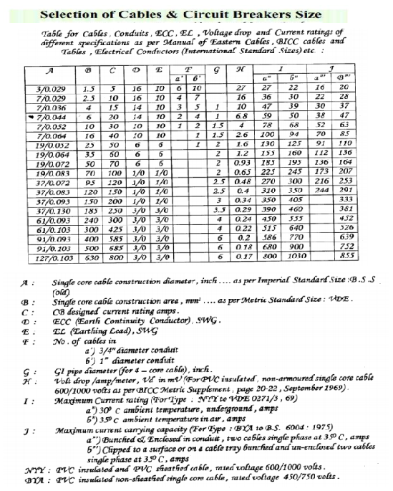
References

Slide 54
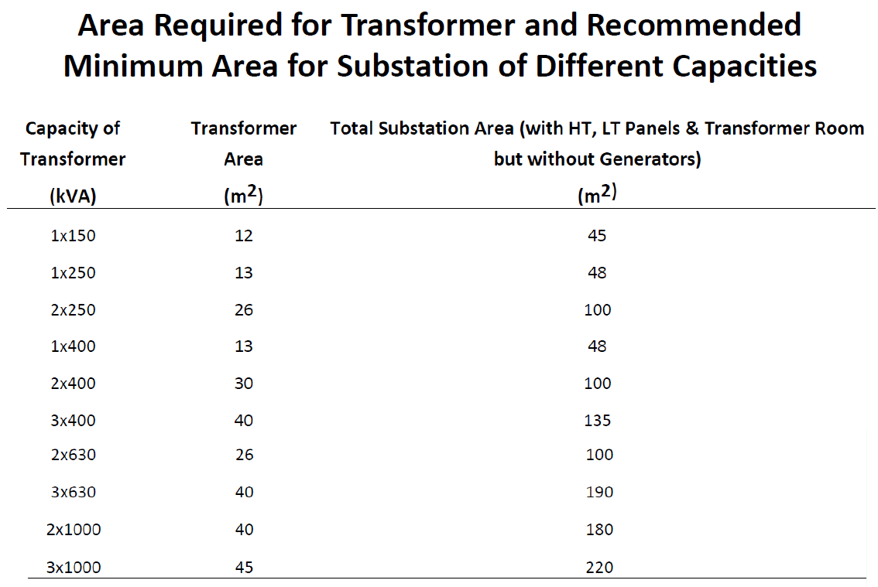
References

Slide 55


